Slide 1
Drowsiness Detection
RNS INSTITUTE OF TECHNOLOGY
BENGALURU - 98
DEPARTMENT OF COMPUTER SCIENCE & ENGINEERING
Presentation on Internship
Harshith K
1RN19CS054
O A Devasish Kumar
1RN19CS094

Slide 2
AGENDA
Abstract
About the Company
Introduction
Literature Survey
Requirements
System Design
Detailed Design
Implementation
Results
Conclusion and Future Enhancements
References
Q & A
VIII Semester, Department of CSE, RNSIT
2021 - 2022

Slide 3
ABSTRACT
Drowsiness Detection is an application of artificial intelligence. Artificial Intelligence is a method by which systems can automatically learn as well as improve without being explicitly programmed.
Transport systems are an essential part of human activities.
We can all be a victim of drowsiness while driving.
The proposed system aims to lessen the number of accidents that occur due to driver’s drowsiness which will in turn improve transportation safety.
This project uses the concept of image processing to detect whether a driver is drowsy or not.
VIII Semester, Department of CSE, RNSIT
2021 - 2022

Slide 4
ABOUT THE COMPANY
NASTECH – New Age Solutions & Technologies
NASTECH is formed with the purpose of bridging the gap between Academia and Industry.
Nastech is one of the leading Global Certification and Training service providers for technical and management programs for educational institutions.
They collaborate with educational institutes to understand their requirements and form a strategy in consultation with all stakeholders to fulfill those by skilling , reskilling and upskilling the students and faculties on new age skills and technologies.
Industry and project oriented student training programs.
Certification programs mapped to Global Certification Exams from Microsoft/EC- Council/Google/AWS/ Adobe).
VIII Semester, Department of CSE, RNSIT
2021 - 2022

Slide 5
INTRODUCTION
Automotive population is increasing exponentially in our country. The biggest problem regarding the increased use of vehicles is the raising number of road accidents. The frequency of road accidents in India is among the highest in the world.
The major driver errors are caused due to drowsiness and reckless mistakes. In order to minimize the effects of driver abnormalities, our project focuses on detecting the drowsiness of a driver.
Hence, we built a system using python, Open CV and dlib which will alert the driver when he feels sleepy. It detects when a person’s eyes are closed for some amount of time.
VIII Semester, Department of CSE, RNSIT
2021 - 2022

Slide 6
LITERATURE SURVEY
1. IEEE Conference: 2020 24th International Computer Science and Engineering Conference (ICSEC) by Sunsern Cheamanunkul Mahidol University International College Nakhon Pathom, Thailand 73170 Sanchit Chawla Mahidol University , Implies that Given a set of input videos and their labels D = {(X1, y1),(X2, y2),...,(Xn, yn)} where yi is either drowsy or non-drowsy. We find that support vector machines (SVM) classifiers give average cross validation accuracy up to 81.7%. The number of calculations involved due to various formulas are more. Therefore sometimes the output has a delay.
2. IEEE 2019 21st International Conference by Lee, Kyong Hee; Kim, Whui; Choi, Hyun Kyun; Tae Jang, Byung on Advanced Communication Technology (ICACT) - PyeongChang Kwangwoon_Do, Korea (South) . In this paper, the possible driver condition estimation techniques are explained using image feature extraction analyses.The proposed method is for extracting detailed features of the eyes, the mouth, and positions of the head using OpenCV and Dlib library in order to estimate a driver’s level of drowsiness.
VIII Semester, Department of CSE, RNSIT
2021 - 2022

Slide 7
LITERATURE SURVEY
3. IEEE 2020 International Conference on Communication and Signal Processing (ICCSP) - Chennai, India by K.Satish, A.Lalitesh, K. Bhargavi, M.Sishir Prem and Anjali.T. Two ways are used to detect the drowsiness of a person effectively. First Driver face is captured and eye retina detection and facial feature extraction are done and blinking values are calculated then threshold values are set. Secondly, the Arduino module is used which is integrated with elastomeric sensors for real-time calculation of driver hand pressure on the car steering wheel and the threshold value is set.
The result from both methods is taken as input for taking the final decision and alerting the driver. Load cell sensor is used for giving input to the controller whenever hand pressure is increased on hand wheel values are sent to the microcontroller.
VIII Semester, Department of CSE, RNSIT
2021 - 2022

Slide 8
REQUIREMENTS
HARDWARE REQUIREMENTS
  Processor : Any Processor above 500 MHz
  RAM : 512Mb
  Hard Disk : 4 GB
  Input device : Standard Keyboard and Mouse
  Output device : VGA and High Resolution Monitor
SOFTWARE REQUIREMENTS
  Operating system : Windows 10
  IDE : Jupyter Notebook
  Tools/Technologies : Python, Computer Vision, OpenCv, Tenserflow and Keras API, Numpy library,
        Pygame.
VIII Semester, Department of CSE, RNSIT
2021 - 2022

Slide 9
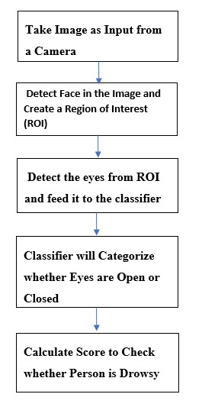
SYSTEM DESIGN
As depicted in the figure, the project is divided in two phases.
Phase 1 deals with loading, preprocessing and training the data set. In this phase, the model that performs training on the data set the best, in other words, the model that provides highest accuracy, is saved onto the disk.
Phase 2 deals with loading the model that was saved in the previous phase, to test it by feeding a real time video.
The OpenCV library is used to detect faces in the video stream that is fed continuously to the model.
From each face that is detected, the region of interest (ROI) is extracted and the classifier is applied to the extracted image to detect whether the person in the image is closing their eyes or not.
PHASE 1
PHASE 2
VIII Semester, Department of CSE, RNSIT
2021 - 2022

Slide 10
DETAILED DESIGN
FUNCTIONAL MODULES
  The entire project is divided into 3 modules:
    Face Tracking
    Eye Detection
1. Face tracking
Due to the real-time nature of the project, the faces need to be tracked continuously for any form of distraction. Hence the faces are continuously detected during the entire time.
If faces are found, it returns the positions of detected faces as rect(x,y,w,h). Once these locations are returned, we can draw a rectangular box around the location that would depict the region of interest( ROI) for the face .
  2 . Eye Detection:
    The module detects whether the driver’s eye is open or closed based on image processing.
    A score keeps track of the state in which the eye is. When the eyes are closed for too long, the score increases until it reaches a score of 15 after which a beep sound is produced to alert the driver.
VIII Semester, Department of CSE, RNSIT
2021 - 2022

Slide 11
IMPLEMENTATION
TRAINING CODE
import cv2
import dlib
from scipy.spatial import distance
def calculate_EAR(eye):
A = distance.euclidean(eye[1], eye[5])
B = distance.euclidean(eye[2], eye[4])
C = distance.euclidean(eye[0], eye[3])
ear_aspect_ratio = (A+B)/(2.0*C)
return ear_aspect_ratio
cap = cv2.VideoCapture(0)
hog_face_detector = dlib.get_frontal_face_detector()
dlib_facelandmark = dlib.shape_predictor("shape_predictor_68_face_landmarks.dat")
while True:
_, frame = cap.read()
gray = cv2.cvtColor(frame, cv2.COLOR_BGR2GRAY)
faces = hog_face_detector(gray)
for face in faces:
face_landmarks = dlib_facelandmark(gray, face)
leftEye = []
rightEye = []
for n in range(36,42):
x = face_landmarks.part(n).x
y = face_landmarks.part(n).y
leftEye.append((x,y))
next_point = n+1
if n == 41:
next_point = 36
x2 = face_landmarks.part(next_point).x
y2 = face_landmarks.part(next_point).y
cv2.line(frame,(x,y),(x2,y2),(0,255,0),1)
for n in range(42,48):
x = face_landmarks.part(n).x
y = face_landmarks.part(n).y
rightEye.append((x,y))
next_point = n+1
if n == 47:
next_point = 42
x2 = face_landmarks.part(next_point).x
y2 = face_landmarks.part(next_point).y
cv2.line(frame,(x,y),(x2,y2),(0,255,0),1)
left_ear = calculate_EAR(leftEye)
right_ear = calculate_EAR(rightEye)
VIII Semester, Department of CSE, RNSIT
2021 - 2022

Slide 12
IMPLEMENTATION
TRAINING CODE
EAR = (left_ear+right_ear)/2
EAR = round(EAR,2)
if EAR<0.26:
cv2.putText(frame,"DROWSY",(20,100),
cv2.FONT_HERSHEY_SIMPLEX,3,(0,0,255),4)
cv2.putText(frame,"Are you Sleepy?",(20,400),
cv2.FONT_HERSHEY_SIMPLEX,2,(0,0,255),4)
print("Drowsy")
print(EAR)
cv2.imshow("Are you Sleepy", frame)
key = cv2.waitKey(1)
if key == 27:
break
cap.release()
cv2.destroyAllWindows()
VIII Semester, Department of CSE, RNSIT
2021 - 2022

Slide 13
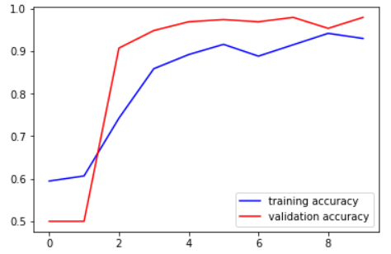
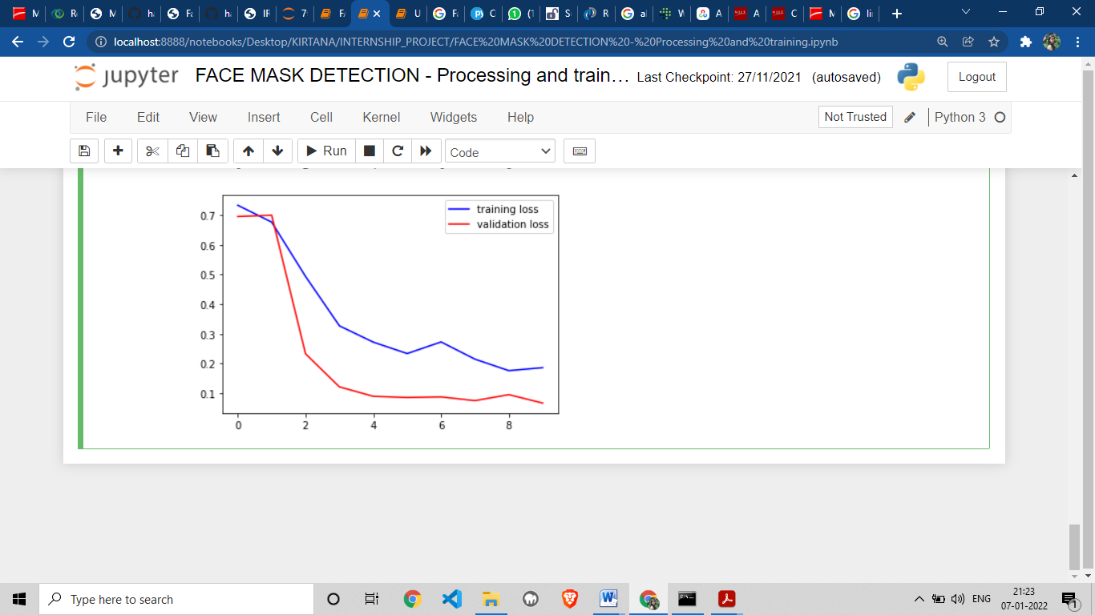
RESULTS
It can also be observed in the accuracy loss graph obtained below:
  The accuracy of the model is 94,97,93% as eyes closed and 99,100,98% as eyes open
  The loss value is below 0.1.
It can be observed that with every iteration of the model training, the loss is getting gradually decreased and the accuracy is getting increased.
VIII Semester, Department of CSE, RNSIT
2021 - 2022

Slide 14
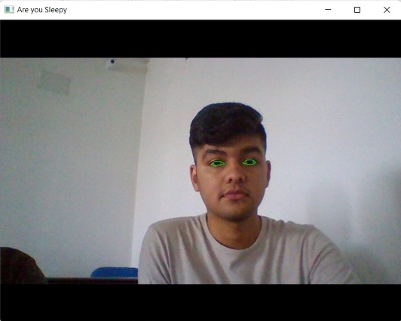
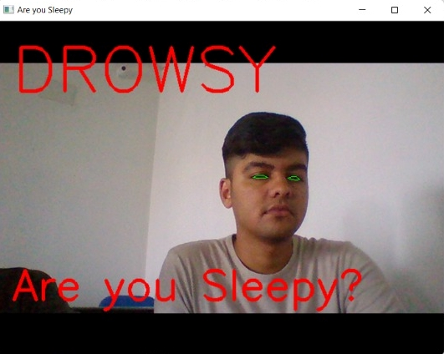
RESULTS
VIII Semester, Department of CSE, RNSIT
2021 - 2022

Slide 15
CONCLUSIONS
The designed sleepiness detection and correction system is capable of detecting tiredness quickly.
The technology can determine if the eyes are open or closed during the monitoring. We used the CNN algorithm to implement it, where we established a score threshold, the score climbs when the individual closes his eyes, and the driver is warned by an alarm buzz when the score crosses the threshold value.
In this project, a deep learning model for drowsiness detection was developed with the help of Convolutional Neural Networks using Python, dlib, and OpenCV.
The model is predicting with 94,97,93% accuracy as ‘eyes closed’ and 2,3,5% as eyes open.
The model is predicting with 99,100,98% accuracy as ‘eyes open’ and 2,3,5% as eyes closed.
VIII Semester, Department of CSE, RNSIT
2021 - 2022

Slide 16
LIMITATIONS
The system has difficulty detecting certain faces when wearing a mask.
This problem is due to the fact that initially, the Open CV Deep Learning based face detector was being used and it is not designed to detect faces with masks and glasses.
It could also be observed that the face recognition stage is not robust when the detected face presents a certain angle of inclination.
However, this is not a problem of great impact, as this application is oriented to access control and at this point, the person must maintain a firm and straight posture in front of the device that acquires the image.
VIII Semester, Department of CSE, RNSIT
2021 - 2022

Slide 17
FUTURE ENHANCEMENTS
Future research may focus on measuring weariness using external parameters such as vehicle states, sleeping hours, weather conditions, mechanical data, and so on.
One critical step in a series of preventive measures necessary to solve this problem is to monitor the driver's level of drowsiness and vigilance and provide feedback on their condition so that they can take appropriate action.
Currently, the camera's zoom and direction cannot be adjusted while in operation. Once the eyes have been located, next development may include automatically zooming in on them.
VIII Semester, Department of CSE, RNSIT
2021 - 2022

Slide 18
REFERENCES
[1] Gayatri Deora, Ramakrishna Godhula and Dr. Vishwas Udpikar “Study of Masked Face Detection Approach in Video Analytics”. 2016, IEEE Conference on Advances in Signal Processing.
[2] S. Meivel, K. Indira Devi, S. Uma Maheswari , J. Vijaya Menaka “Real time data analysis of face mask detection and social distance measurement using Matlab”, Dec 2020.
[3] Mingjie Jiang, Xinqi Fan and Hang Yan “Retinal Face Mask Detector”. 9 June 2020, Hong Kong University.
[4] https://docs.opencv.org/3.4/db/d28/tutorial_cascade_classifier.html
[5] https://medium.com/analytics-vidhya/haar-cascades-explained-38210e57970d
VIII Semester, Department of CSE, RNSIT
2021 - 2022

Slide 19
Question and Answer
VIII Semester, Department of CSE, RNSIT
2021 - 2022

Slide 20
THANK YOU
VIII Semester, Department of CSE, RNSIT
2021 - 2022

